Slide 1
INDIAN INSTITUTE OF INFORMATION TECHNOLOGY, KOTA
Department of Computer Science and Engineering
Final Year Project Presentation
Topic: Analysis of Various Land Use/Land Cover patterns over various regions of India using Machine Learning.
Submitted By:
Saharsh Sharma 2018kucp1063
Vishay Yadav 2018kucp1134
Shaurya 2018kucp1136
Rajvir Singh 2018kucp1138
Mentor:
Dr. Priyanka Mishra
Assistant Professor
Department of CSE
IIIT KOTA

Slide 2
Introduction and Motivation
Urbanization takes place when rural areas are incorporated into cities, typically in the form of outgrowing radiation coming out from the city center or linearly along major transportation corridors.
Due to an uneven distribution of population, this urbanization has shown undistributed patterns which can lead to misinformation in the Population data and census, and wastage of resources.
Previous researches measured urbanization through census data and door-to-door surveys.
But, with an increase in the availability of Remote Sensing data and rapid developments in the field of Machine Learning, the task of urban research has become quite easy.

Slide 3
Problem Statement
To classify the different regions of Delhi, India, into Built-Up and Non Built-Up areas, using Machine Learning models on Landsat 7 data in Google Earth Engine.

Slide 4
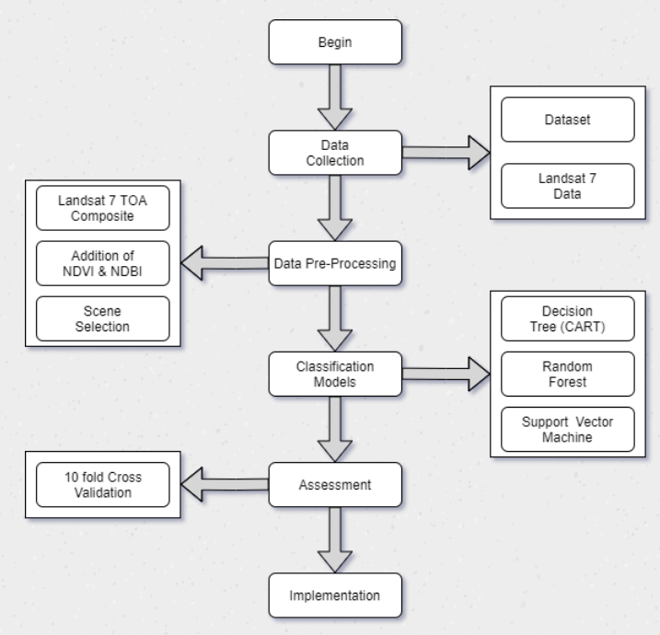
Methodology

Slide 5
Google Earth Engine
Google Earth Engine (GEE) is a cloud-based computational platform and Geographic Information System (GIS) tool used to display maps and synthesize the geographical data and to run geospatial analysis on Google's infrastructure.
It is a huge platform with petabytes of satellite images and geospatial data. The data on GEE are the contributions of various satellites such as ASTER, MODIS, and Landsat. Thus, it has a timeline of satellite data.
It comes along with the web-based IDE at code.earthengine.google.com for the Earth Engine JavaScript API. Code Editor features are designed to make developing complex geospatial workflows fast and easy.
It is a huge platform with numerous kinds of available data for carrying out research using satellite data. For e.g. Global Forest Cover Change is a project developed by the World Resource Institute to monitor the forests of the world in real-time.

Slide 6
Data Set
The dataset used for this study is as presented in the research paper: "Detecting the Boundaries of Urban Areas in India: A dataset for Pixel-based Classification in Google Earth Engine (Remote Sens., vol. 8(8) , no. 634 (2016)).”
It consists of 21, 030 polygons (Geographically mapped areas) which have been manually classified under two classes: Built-Up and Non-Built-Up. These polygons are of size 30mx30m (on Map Scale) which are randomly distributed over the mainland India.
The polygons with more than 50% area covered with man-made structures are classified into Built-up and the remaining as Non-Built-Up.
The dataset was generated using WorldPop, a per-pixel population estimation of the 2010- 2011 India census dataset to create the sampled polygons.

Slide 7
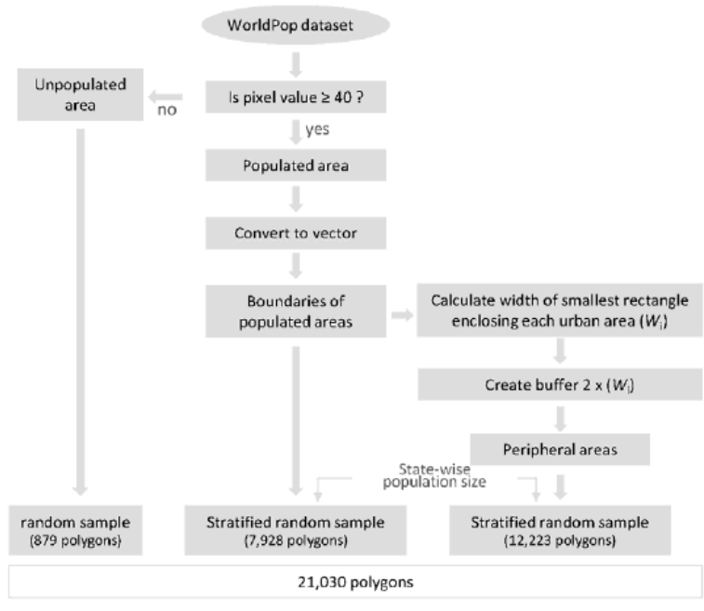
Data Set Construction Flow Chart

Slide 8
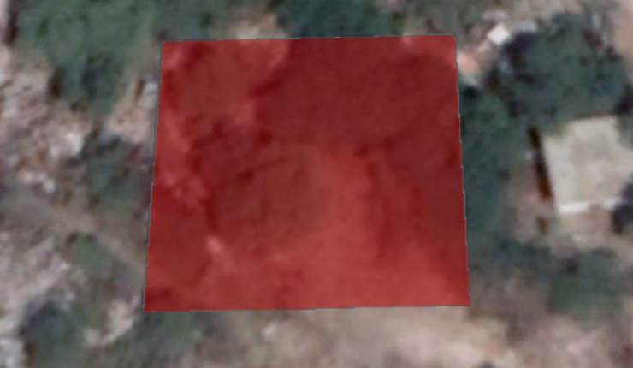
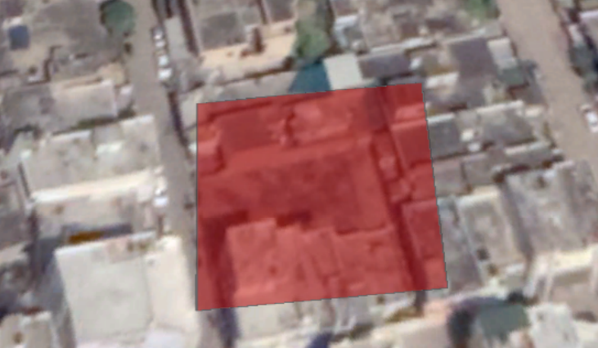
Satellite View of Polygon Representation
Non- Built up
Built up

Slide 9
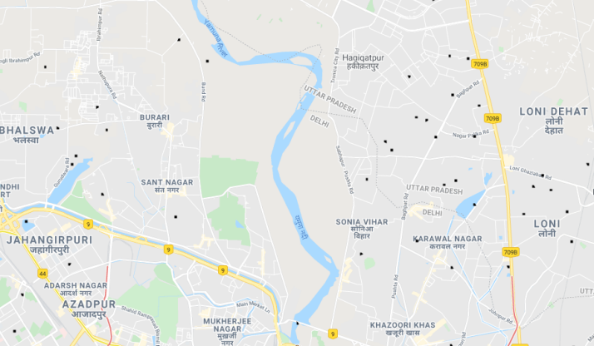
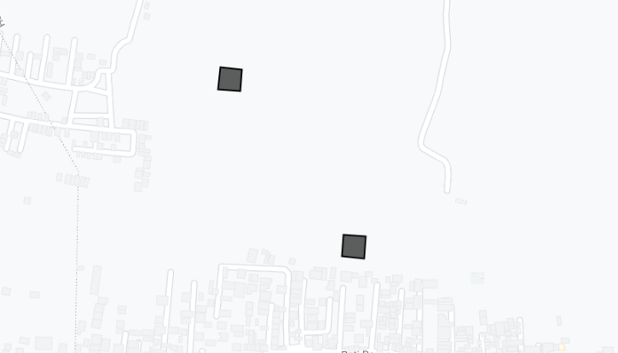
Map View of Polygon Representation

Slide 10
Study Area
For our analysis, we selected ‘Delhi’ as the region of interest.
Delhi, which is officially known as ‘National Capital Territory of Delhi’(NCT), and is the capital of India,covers an area of 1484 square kilometres (573 sq mi). It is located between 28°-24′-17″ N, 76°-50′-24″ E and 28°-53′-00″ N, 77°-20′-37″ E.
From the dataset obtained, we have used the polygons over our area of study, which amount to a total of 286 such polygons.

Slide 11
Pre-Processing and Scene Selection
After retrieving the dataset, we used the Landsat 7 Surface Reflectance (TOA-1) data of the year 2014 (available in GEE) as input for classification which consists of 8 different bands of different wavelengths (micrometers).
We use the Landsat 7 annual TOA percentile composite (2014), which is a composite of pre-processed scenes, that is available on GEE. This composite includes Top of Atmosphere (TOA) calibrated Landsat 7 data, which were filtered to include data of the year 2014 with no negative sun elevation.
The composite further includes pixels with the lowest cloud cover, computed as per-band percentile values that have been scaled to 8 bits ([0,255]) (for bands 1 to 5, band 7 and 8) or to units of Kelvin-100 (for band 6).
We add two additional indices as bands to the Landsat 7 data, so that it can improve the classification: Normalized Difference Vegetation Index (NDVI) and Normalized Difference Built-Up Index (NDBI).

Slide 12
NDVI: It communicates the relation between the visible red light (which is absorbed by a plant’s chlorophyll) and near-infrared wavelength (which is dispersed by the leaf’s mesophyll structure).
Its formula for calculation is: (NIR - RED) / (NIR + RED)
For Landsat 7, it is calculated as: (Band 4 – Band 3) / (Band 4 + Band 3)
The value of NDVI ranges from -1 to +1. Higher value of NDVI represents dense vegetation

Slide 13
NDBI: It communicates the relation between the medium-infrared and near-infrared wavelengths.
Its formula for calculation is: (MIR - NIR) / (MIR + NIR)
For Landsat 7, it can be calculated as: (Band 5 - Band 4) / (Band 5 + Band 4)
The value of NDBI ranges from -1 to +1. The non-positive values correspond to water bodies while higher values correspond to Built-Up areas.

Slide 14
Top of Atmosphere (TOA) Reflectance
Reflectance is basically defined as the proportion of the measure of light leaving a target to the measure of light striking the target.
TOA Reflectance is a unitless estimation which gives the proportion of radiation reflected to the incident solar radiation on a given surface.
Sun Elevation Angle
The Sun Elevation Angle is defined as the angle between the geometric center of the solar disk and the observer’s local horizon.
Sun Elevation Angle is negative, when the Sun drops below the observer’s local horizon.

Slide 15
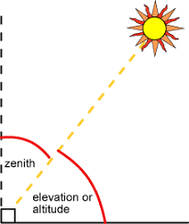

Slide 16
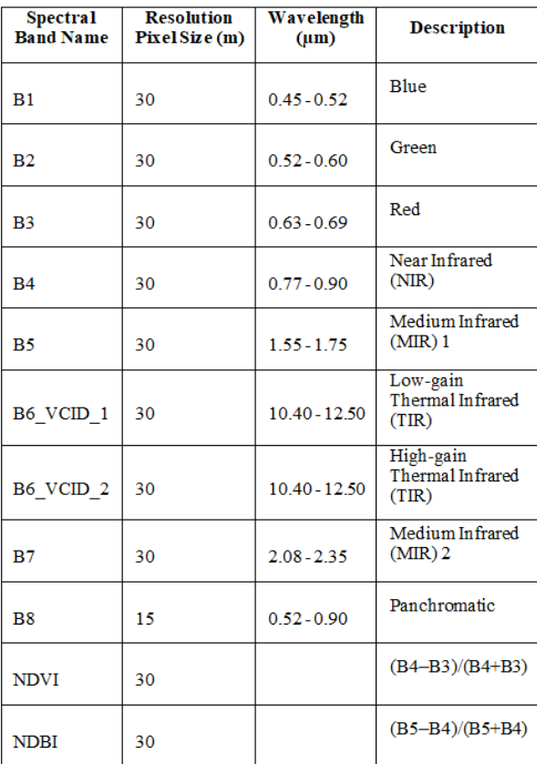
Bands of LANDSAT 7 that were used for classification

Slide 17
Detection of Built-up Areas
To detect the Built-up areas in the GEE, first, we overlay the labeled.
We collected all Landsat 7 points within the area of these polygons along with per-band reflectance values and index values. These sampled points differ from the original number of polygons used, as they entirely do not overlap with the pixels of the Landsat data. Each sample point includes an output binary class: Built-Up or Non-Built Up.
This set of points is used as input to the different classification models. polygons on the input layer.

Slide 18
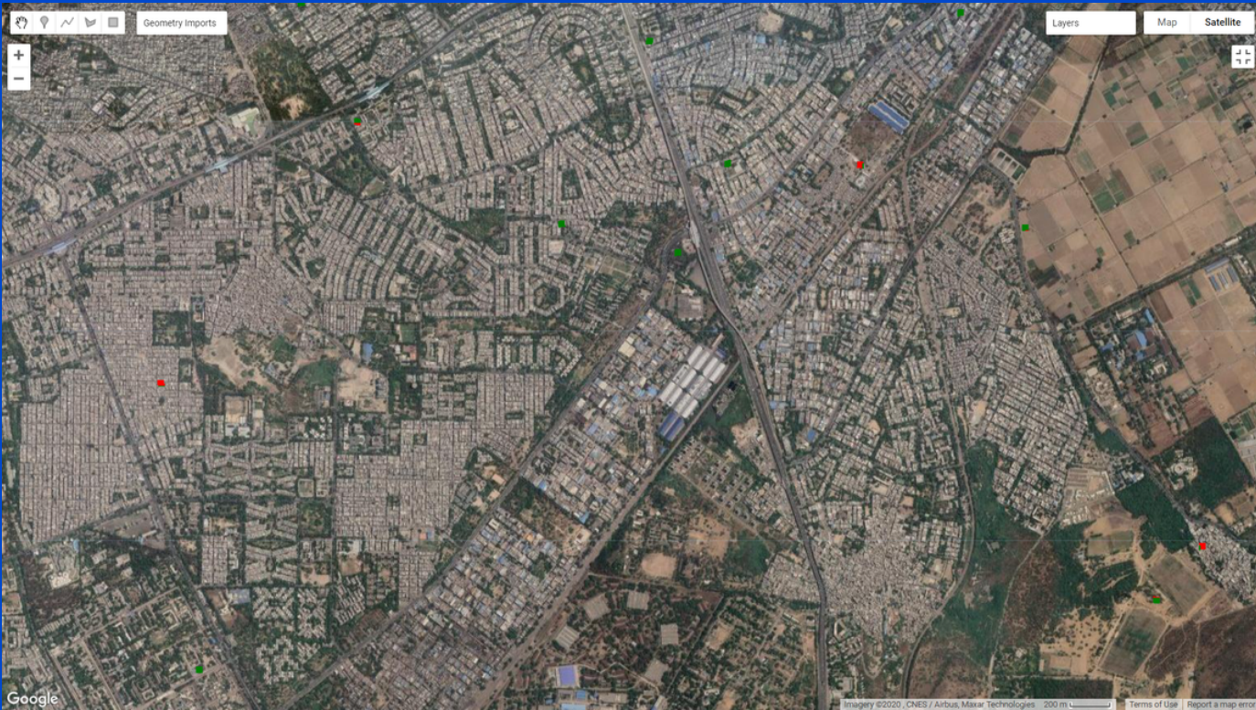
Points after being mapped over points of Landsat 7 composite (Satellite View and Map View) Green dots: Non-Built up and Red Dots : Built up

Slide 19
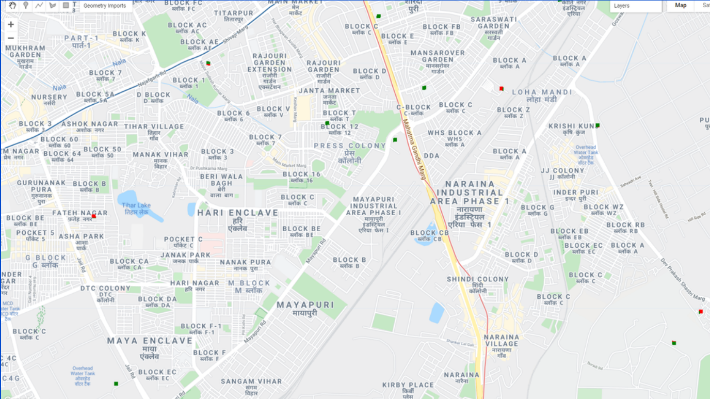

Slide 20
Models
The task of classification is performed using three classification models For evaluating the performance of these models with less-biased estimation, we applied 10-fold cross validation. available in GEE:
1. Decision Tree
2. Support Vector Machine (Linear SVM), a classifier that identifies decision boundaries by optimally separating the classes accordingly.
3. Random Forest, a tree-based classifier that includes k decision trees (k predictors).
For evaluating the performance of these models with less-biased estimation, we applied 10-fold cross validation.

Slide 21
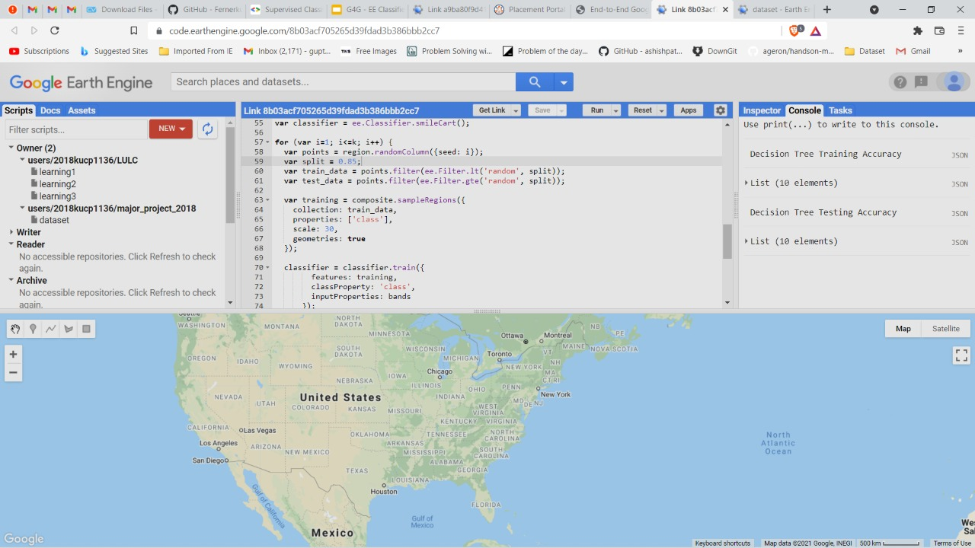

Slide 22
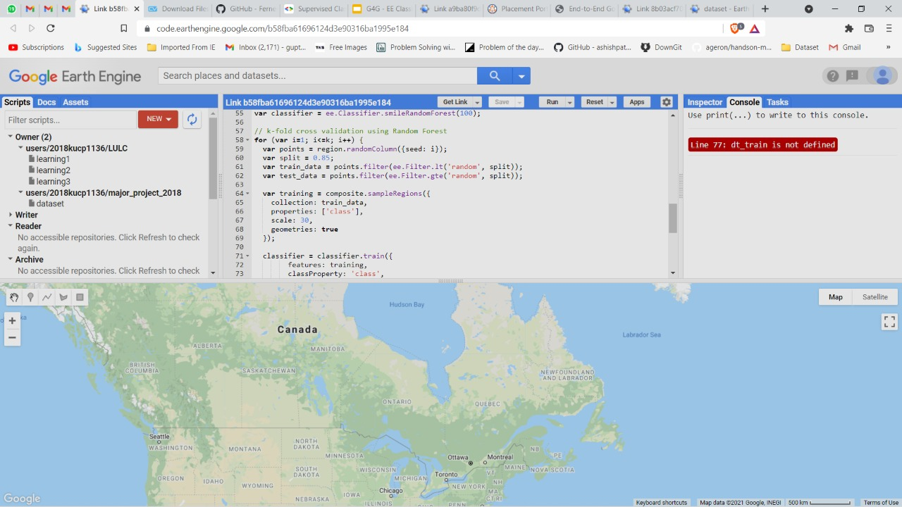

Slide 23
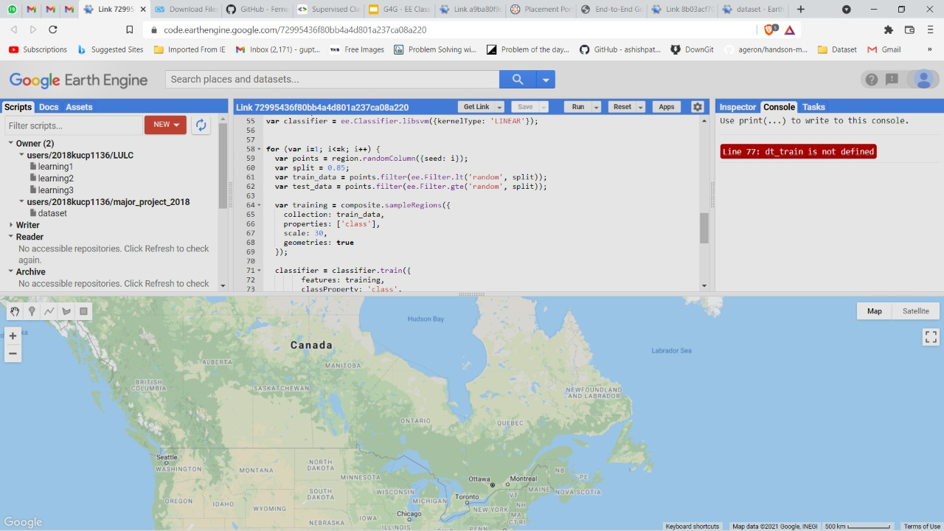

Slide 24
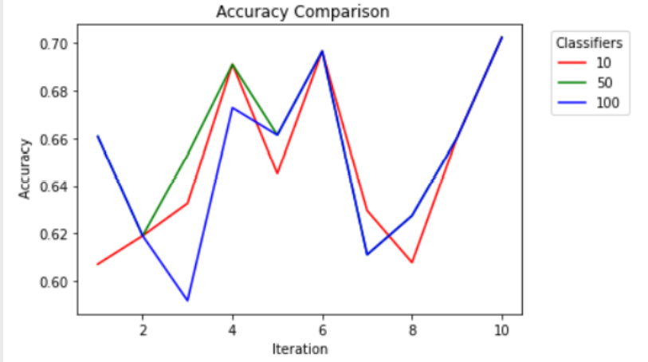
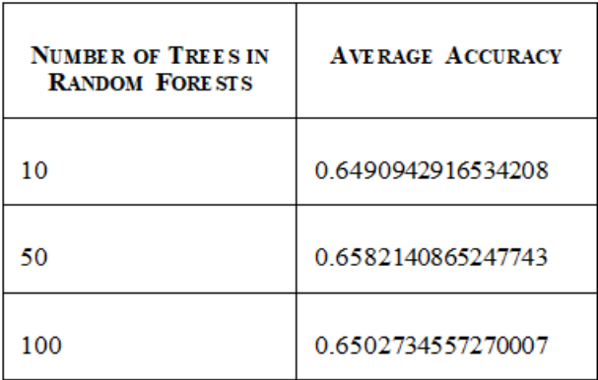
Results
First of all, we performed classification using Random Forest with 10, 50 and 100 trees, and found that Random Forest with 50 trees performed the best among all of them.

Slide 25
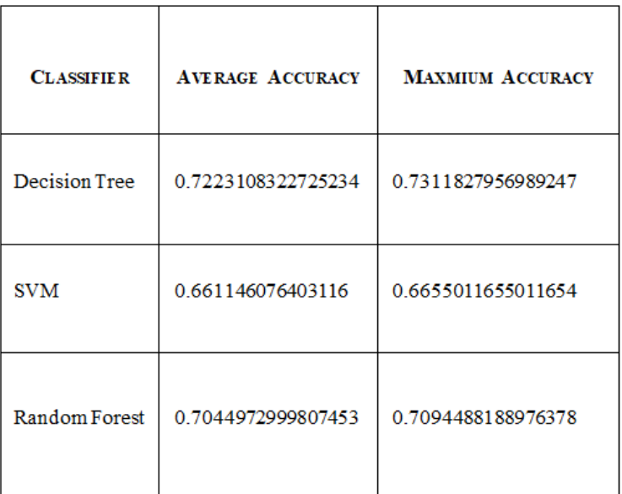
We then performed classification using Decision Tree and Linear SVM, and compared the results with that of Random Forest with 50 Trees.
We found out that the Decision Tree performed the best among all the models and SVM performed the worst.

Slide 26
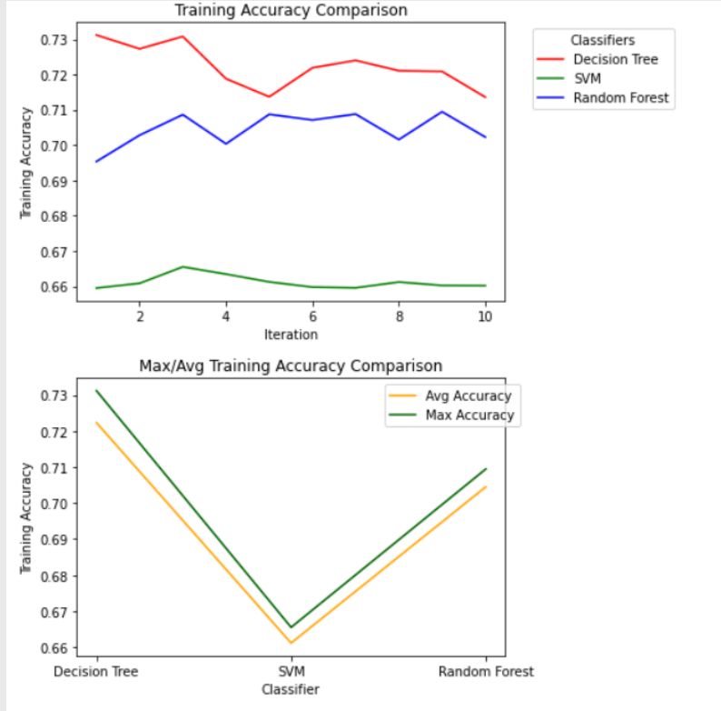

Slide 27
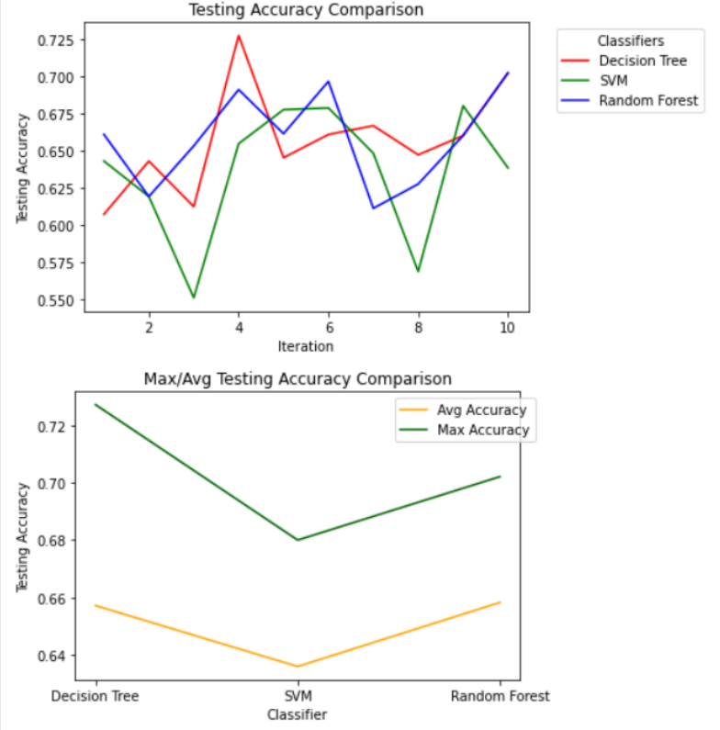

Slide 28
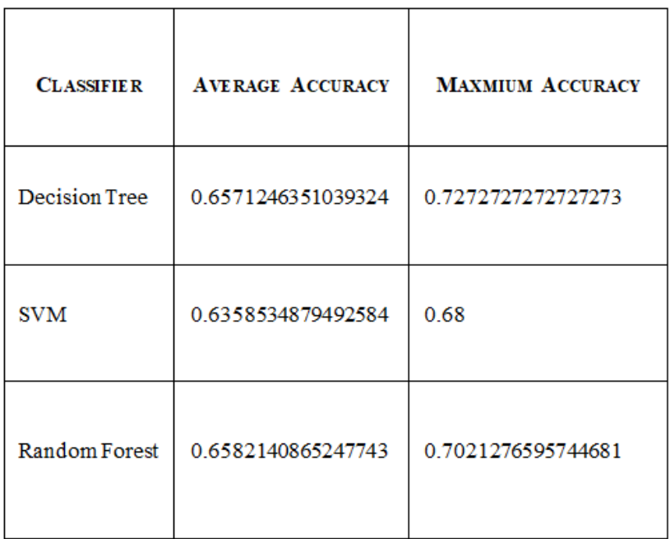

Slide 29
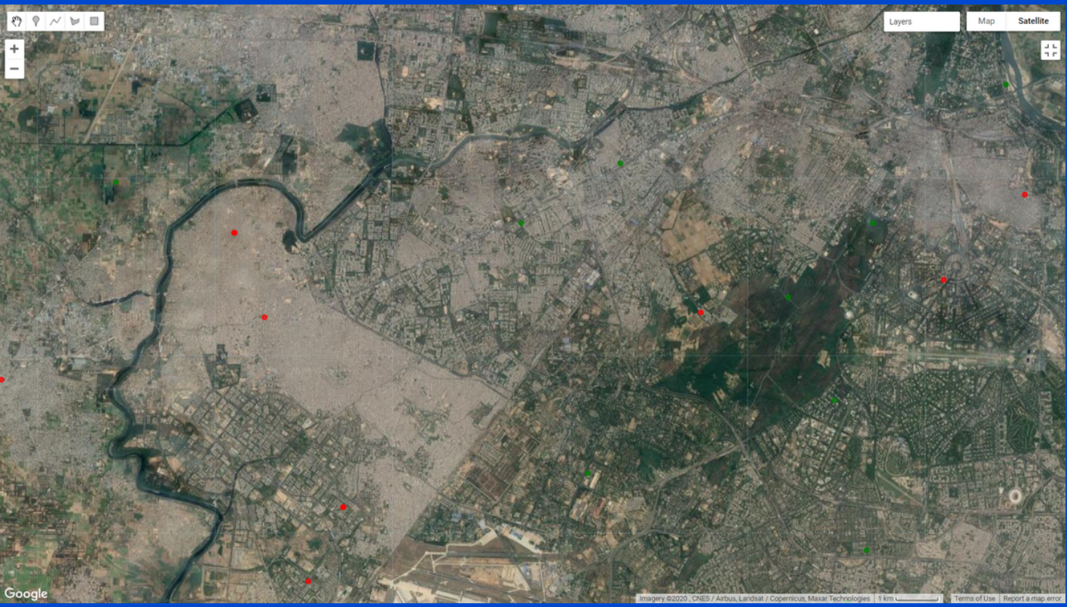
Ground Reality - Satellite View

Slide 30
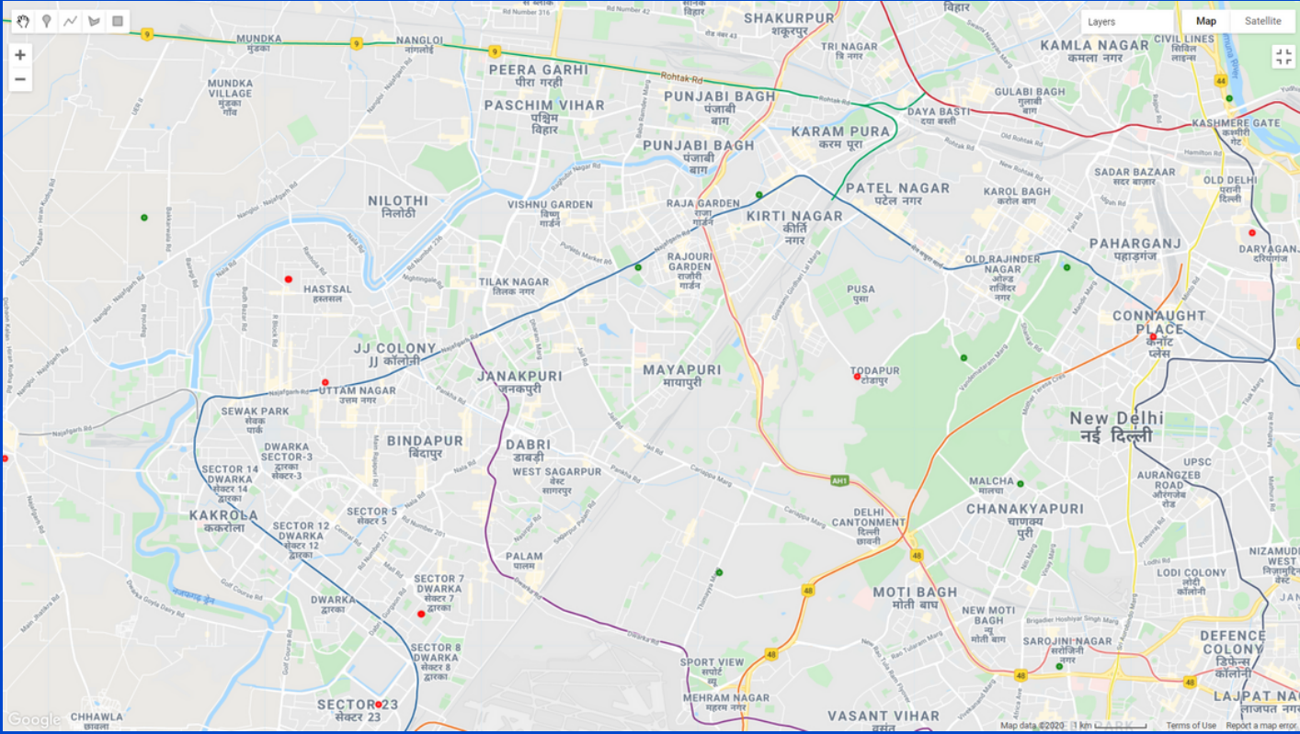
Ground Reality - Map View

Slide 31
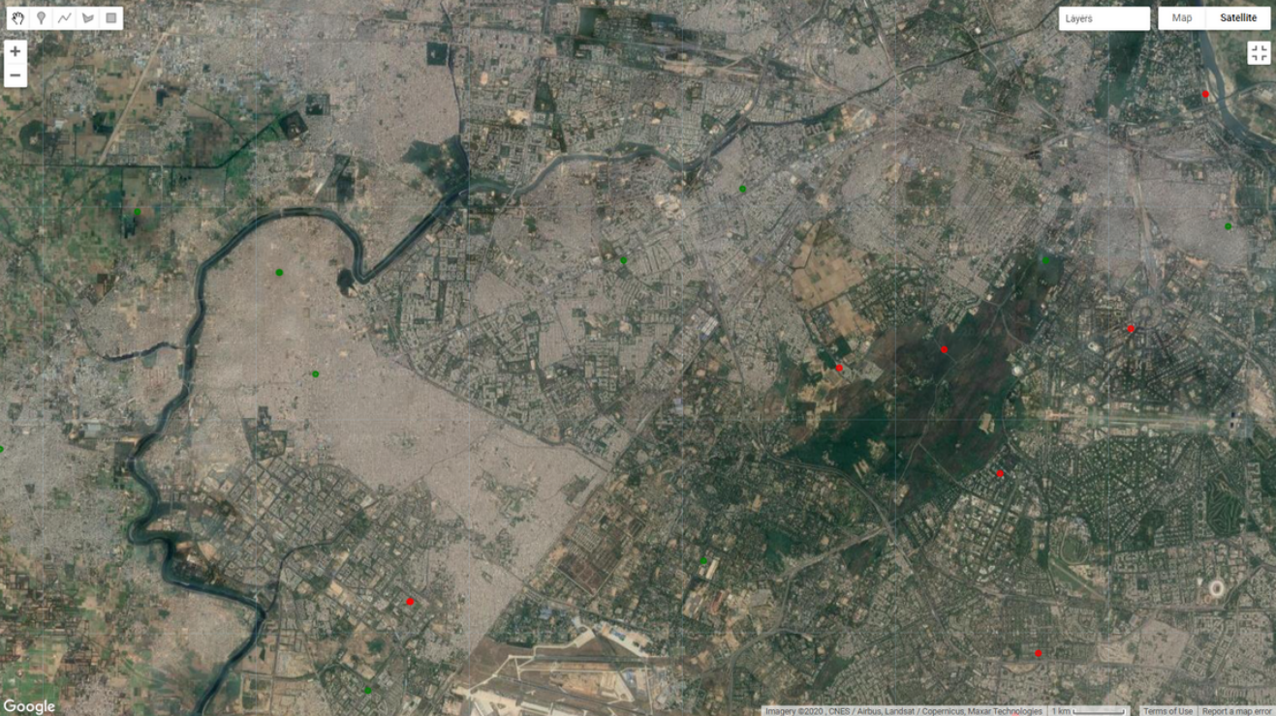
Prediction output of Decision Tree - Satellite View

Slide 32
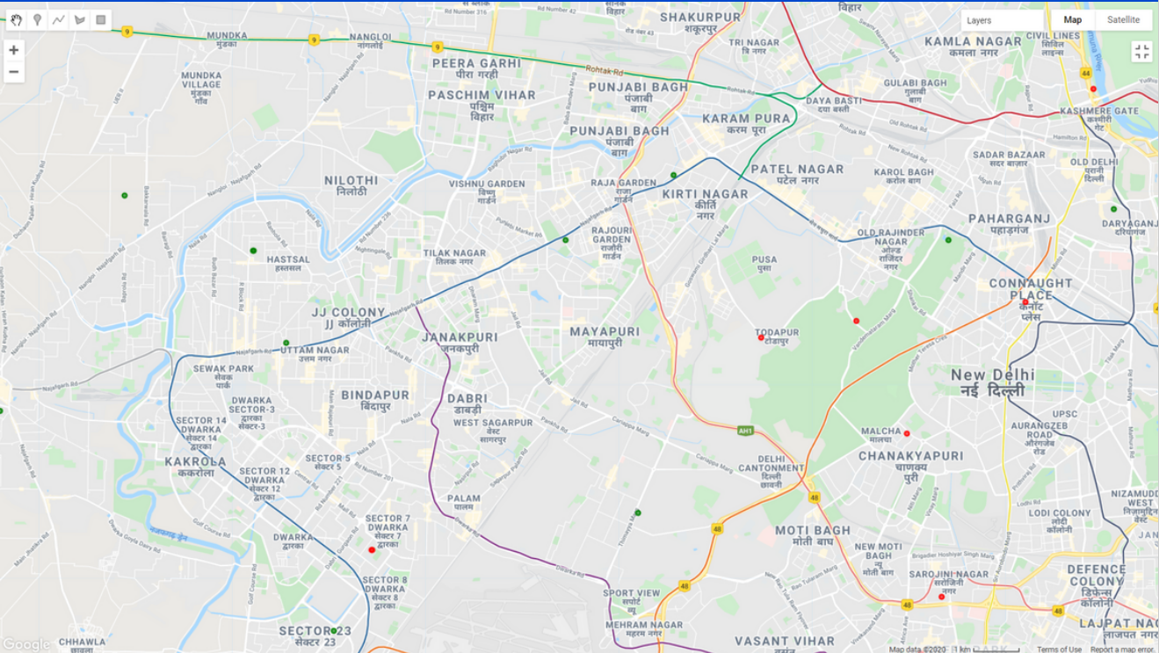
Prediction Output of Decision Tree- Map View

Slide 33
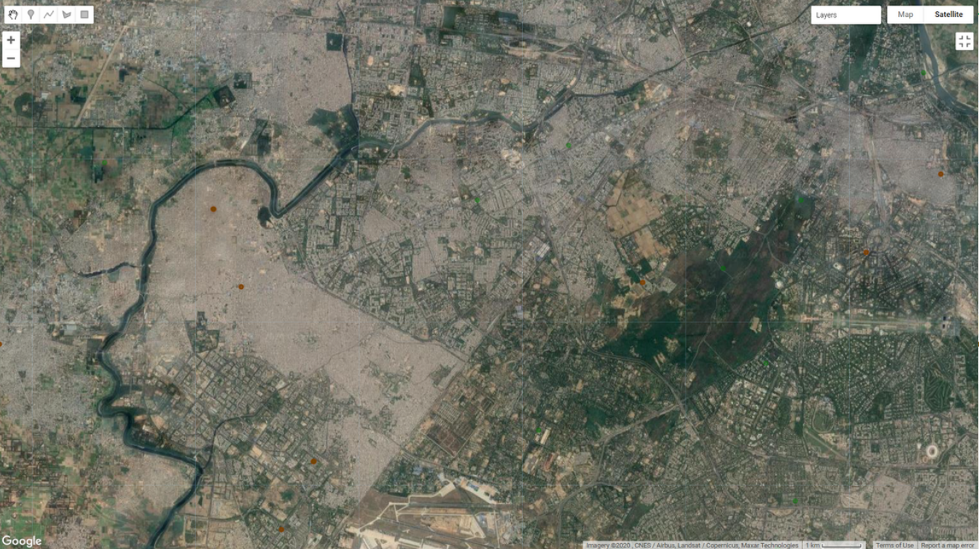
Prediction output of Linear SVM - Satellite View

Slide 34
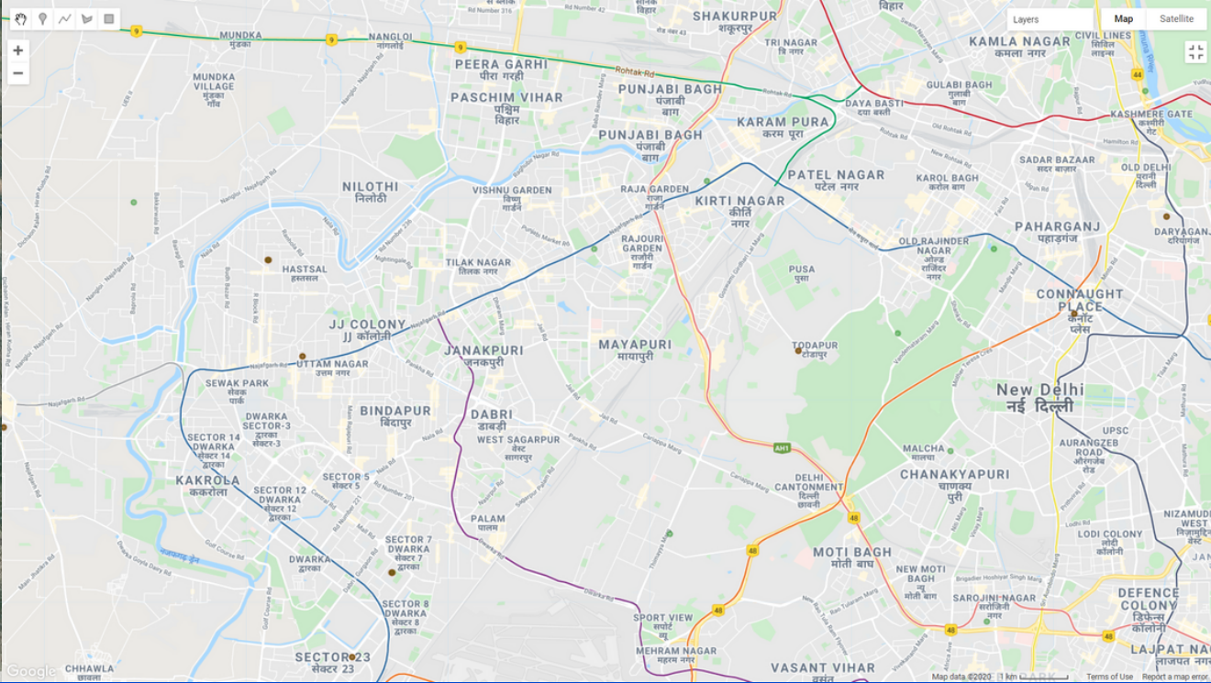
Prediction Output of Linear SVM - Map View

Slide 35
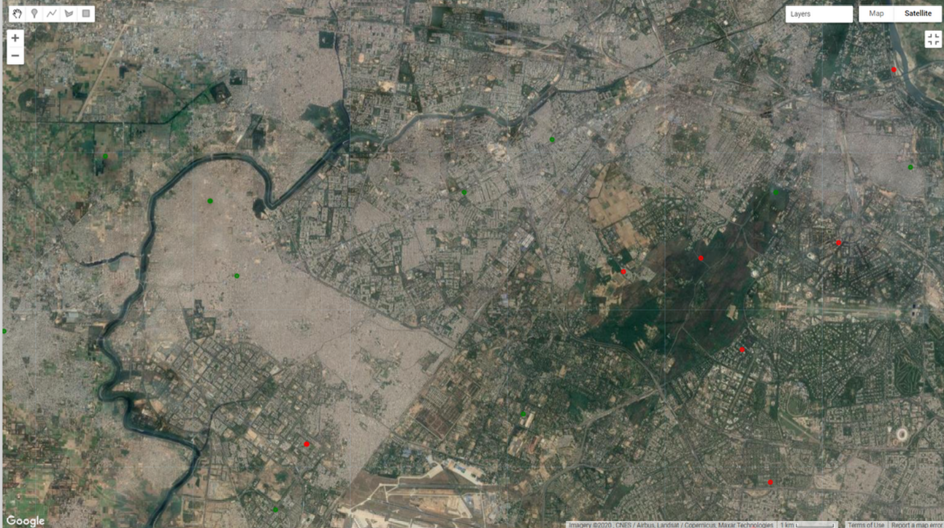
Prediction Output of Random Forest - Satellite View

Slide 36
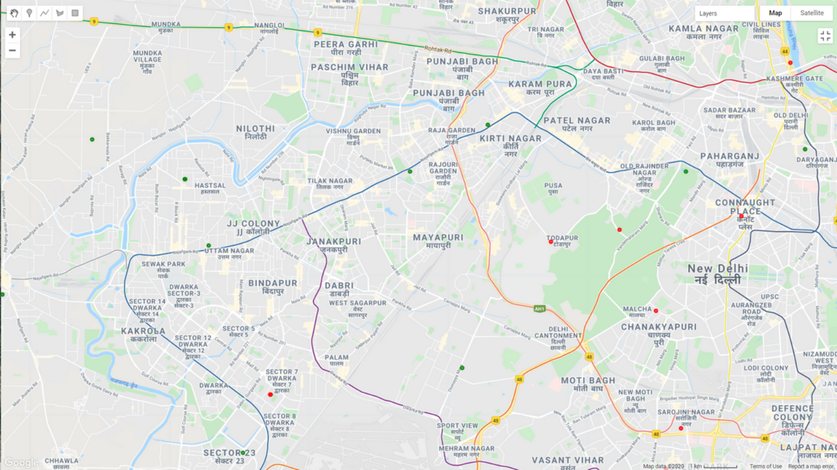
Prediction Output of Random Forest - Map View

Slide 37
Conclusion and Future Scope
From the results obtained, we can conclude that the Decision Tree performs best with a training accuracy of 72% and testing accuracy of 66%.
The average training accuracy for the classifiers is 70% whereas the Average testing accuracy is 65%.
As more and more satellite data over India gets available along with the increase in computational power for geo-spatial analysis, this study can be extended for analyzing a vast number of LU/LC patterns

Slide 38
Acknowledgement
We thank Dr. Priyanka Mishra (Dept. of CSE, IIIT Kota) for her continuous support and guidance throughout the project work.

